Slide 1
Using Logistical regression to predict Yelp user review ratings
Alexander Redd
Introduction to Data Science

Slide 2
YELP
Founded in San Francisco in 2004
As of December 31, 2018 over 170 million reviews have been submitted for all different types of businesses
Yelp released a dataset of its website data for academic purposes
Data provided in JSON format for metropolitan areas in the following locations:
Arizona
Illinois
Nevada
North Carolina
Ohio
Pennsylvania Wisconsin Alberta (Canada) Ontario (Canada) Quebec (Canada)

Slide 3
Starting Point
Six subsets to original Yelp dataset that was released:
Business Information
Checkins
Photos
Reviews
Tips
Users
Imported into R using stream_in() function in jsonlite library
Combined Business Information and Reviews for training dataset

Slide 4
Initial review of the data
Assumptions for the project:
Reviews with less than 3 stars considered “negative”
Reviews with 3 or more stars considered “positive”
False (Not a negative review) | True (Negative review)
230,218 | 69,782
230218/(230218+69782) = 0.7673933 $≈$ 76.7%

Slide 5
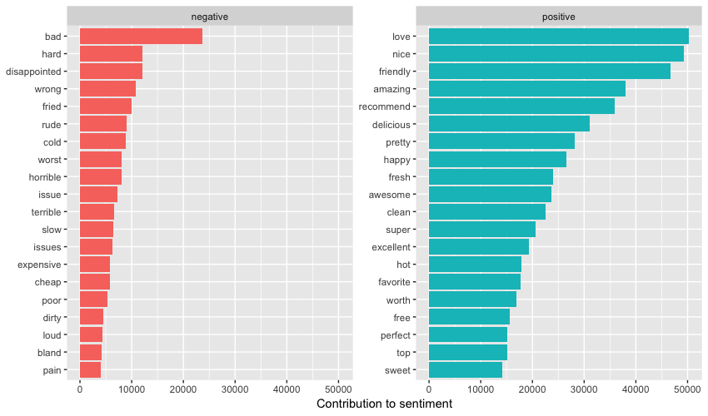

Slide 6
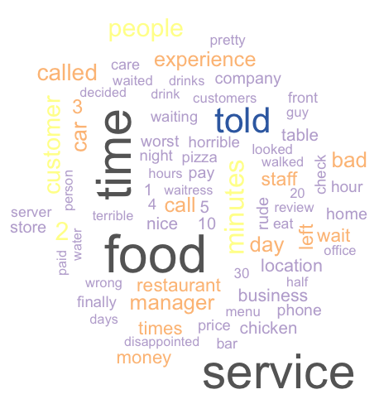
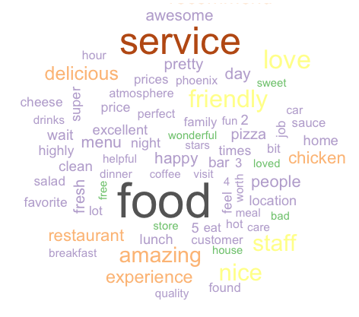
WordCLOUDs
Generated using negative reviews
Generated using positive reviews

Slide 7
Data Wrangling
Words contained in user reviews separated and put into a corpus
All characters converted to lowercase
Punctuation removed
Stopwords from the tm library removed from reviews
Words stemmed
Terms occurring in 2% or more of reviews were used for a total of 453 words using the Bag of Words model
Reviews were split 70/30 – 210,000 reviews for training and 90,000 reviews for testing

Slide 8
Creation of a model
Creation of a model using the rpart library
Used the calculated Negative column to compare columns of recurring words
Words imported as factors requiring method = “class”
Model = rpart ( Negative ~ . , data = trainingData, method = "class")
After creating the model, a decision tree can be created using the rpart.plot library

Slide 9
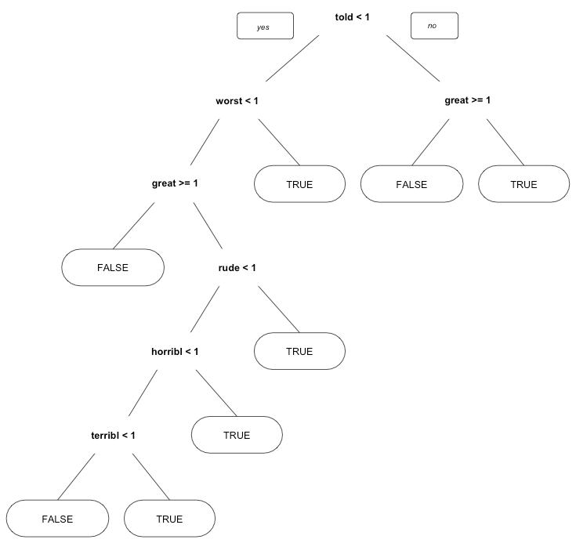
Decision Tree
Interpreting the decision tree
TRUE = Review will likely be “negative”
FALSE = Review will likely be “positive”
Ex. 1 I told my mom it was the greatest shopping experience of my life.
Ex. 2 I will never go back to that horrible place.

Slide 10
Results
 | False | True
False | 66,812 | 2,253
True | 13,212 | 7,723
(66862+7723)/(66862+2203+13215+7723) = 0.8281667 $≈$ 82.8%
Original Dataset $≈$ 76.7%
+6.1%

Slide 11
LEVERAGING THE MODEL
Solution:
Help businesses identify common terms used in negative reviews to know where to focus their efforts to improve customer satisfaction.
Implementation:
Build the logistic regression model results into its website
Provide data to businesses to help improve customer satisfaction
Provide information free of charge to businesses or at a fee
Depending on the Yelp’s business model
At the discretion of executive management

Slide 12
LEVERAGING THE MODEL
Solution:
Identify reviews in which the person erroneously selected a negative rating (less than 3 stars) even though their experience was generally positive.
Implementation:
Yelp provides information to people about businesses in a given area
Star ratings that are inconsistent with the language used in the review, it can lead to a loss in credibility
Verification of language consistent with a positive or negative review either at the time of submission of the review or after the fact
Provide an additional level of quality control

